Slide 1
Language Model and Knowledge Distillation
-----Xinru He

Slide 2
Language Model
What are some large language models:
BERT
GPT2/3
ChatGPT (language modeling with reinforcement learning)
What is language model
A language model is a probability distribution over words or word sequences
How is it trained
Autoregressive
An Autoregressive Model is merely a feed-forward model, which predicts the future word from a set of words given a context. But here, the context word is constrained to two directions, either forward or backward.
Autoencoder
The AE Language Model aims to reconstruct the original data from corrupted inputs.
What can language model do
recognize, summarize, translate, predict and generate text

Slide 3
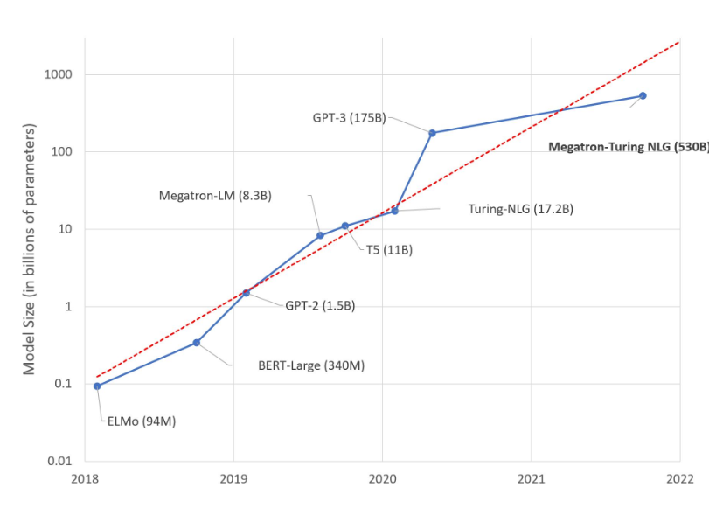
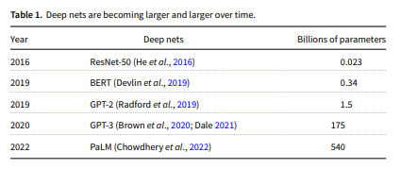
Growing of Language Model

Slide 4
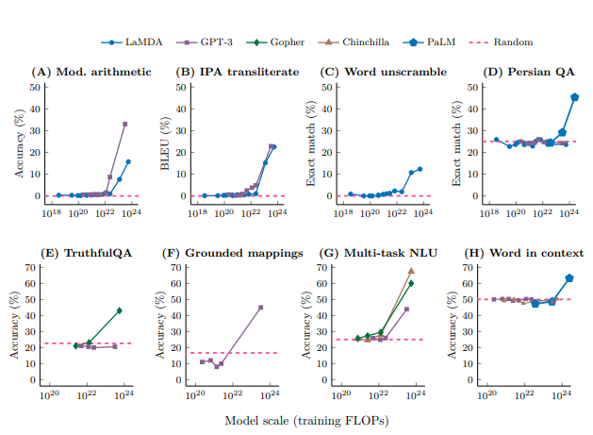
Effect Of Growing

Slide 5
Limitation of Large Language model
Growth is out of control
Why we should limit the growth
budget constraints (including externalities such as global warming)
constraints imposed by deployment platforms (such as phones)
availability of (annotated and unannotated) training data (including externalities such as concerns for invisible workers)
Overfitting
the CoD
Notes:
Emerging trends: Deep nets thrive on scale

Slide 6
Increase the availability of language model
Knowledge Distillation
Teacher -> Student
https://github.com/SforAiDl/KD_Lib
https://github.com/AberHu/Knowledge-Distillation-Zoo

Slide 7
Midpoint checkpoint
Reimplement the code on Github
Understand the core concept of Knowledge Distillation
Evaluate the performance of the student model by testing with different size of teacher model, task and student model
Final Project presentation
Make a presentation of the research project

Slide 8
Citation
Church, Kenneth Ward. "Emerging trends: Deep nets thrive on scale." Natural Language Engineering 28.5 (2022): 673-682.
Radford, Alec, et al. "Language models are unsupervised multitask learners." OpenAI blog 1.8 (2019): 9.
Brown, Tom, et al. "Language models are few-shot learners." Advances in neural information processing systems 33 (2020): 1877-1901.
Wei, Jason, et al. "Emergent abilities of large language models." arXiv preprint arXiv:2206.07682 (2022).
Hinton, Geoffrey, Oriol Vinyals, and Jeff Dean. "Distilling the knowledge in a neural network." arXiv preprint arXiv:1503.02531 (2015).
Devlin, Jacob, et al. "Bert: Pre-training of deep bidirectional transformers for language understanding." arXiv preprint arXiv:1810.04805 (2018).

